Slide 1



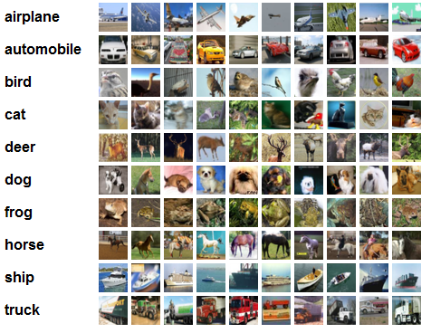
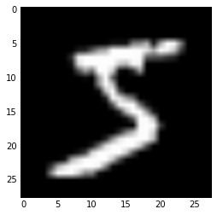






Deep Learning Project
Your names | MSiA 490-30 Deep Learning | Spring 2017 | Northwestern University
Problem Statement
Technical Approach
Results
Statement of the problem, why it matters and to whom
Explain why the problem is hard to solve, and why others haven’t adequately tackled this problem. Describe briefly the approaches already taken to solve the problem.
Describe the technical approach to your problem
Use diagrams to illustrate workflow
Step 1
Describe this step in your experiment
Step 2
Describe this step in your experiment
Step 3
Describe this step in your experiment
Step 4
Describe this step in your experiment
Include results based on your experiments
Where did the model perform well, where did it struggle?
Justify why you think your model made the right decisions using heatmaps or other ways to explain the model
What was the baseline human accuracy? Did the machine get anywhere near that? Why?
Justify why your approach is reasonable compared to alternate approaches
Dataset
Conclusion
Describe your dataset
Show some example data points
Explain how you cleaned the data
Note challenges in working with the data
Explain how much computation power was required to process the data
If applicable, explain how you augmented the data, e.g. shifting data, flipping, changing colors, etc
Was the dataset big enough, do you think overfitting is likely?
Show loss curve during training to see how well the network has learned
Brief summary of what you discovered based on results
Limitations of approach
How to improve/future work
Output
…
$$L_{1}$$
$$L_{2}$$
$$L_{3}$$
References and Related Work
Input
$$W_{1}$$
$$W_{2}$$
Output
Hidden L1
Hidden L2
$$W_{3}$$
Include print and electronic sources in alphabetical order

Slide 2
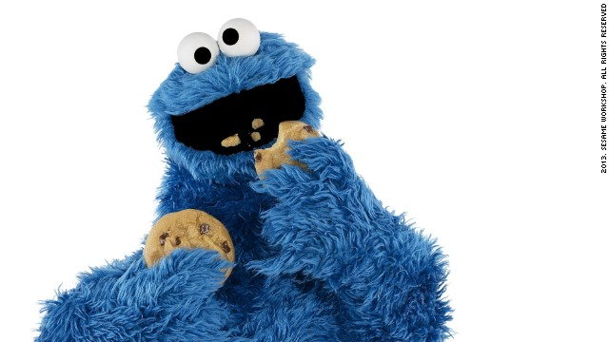
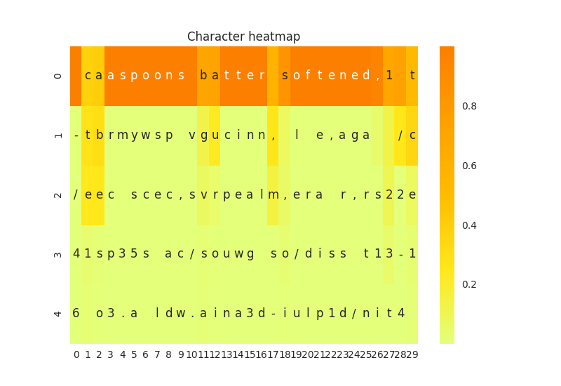
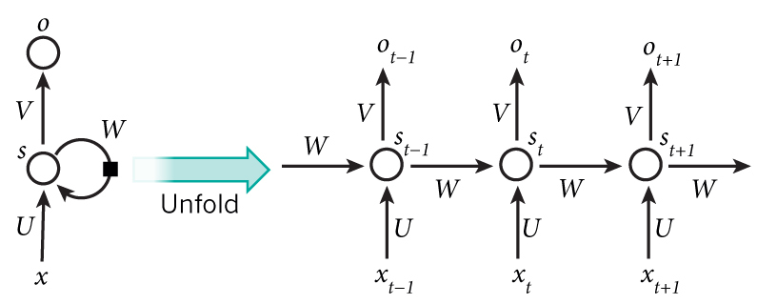
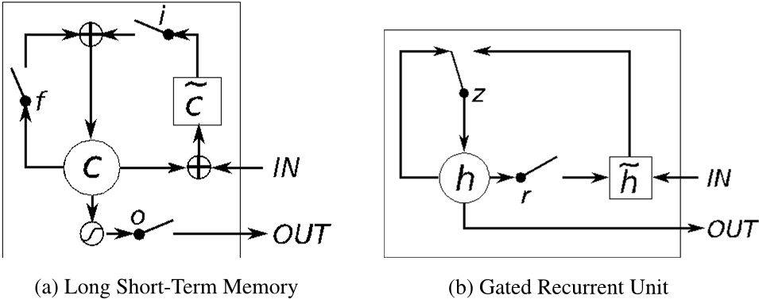
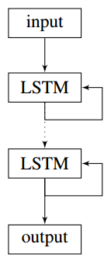
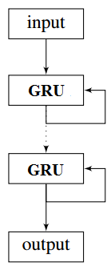
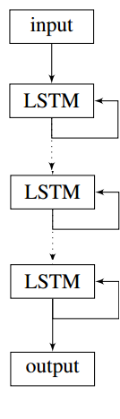
Convectional Neural Networks
Lydia Chang, Stephanie Ger, Ik-Hwan Kim, Craig Ng | MSiA 490-30 Deep Learning | Spring 2017 | Northwestern University
Problem Statement
Technical Approach
Results
Problem: Most people lack the cooking experience to be creative and experiment with different food combinations, but with the help of machine learning (and a lot of data), a model can generate new recipes for them to try.
Difficulty: Current machine learning models are effective at copying and regurgitating inputs, but they are less effective at generating original output from those inputs.
Other approaches: Others have tried to train models on a very general set of recipes that include multiple types of food that include both savory and sweet recipes. However, with a set that broad, the model may become confused because a common ingredient like salt appears in recipes as varied as cakes, burgers and pizzas. In addition, most have trained models including both directions and ingredients, which adds to the complexity and the models tending to learn format rather than content. Finally, most models have utilized character-level generation, which is the most granular and difficult level of generation with regard to text.
Step 1
Step 2
Step 3
Ran the character level CNN and got the following output with the associated heat map.
Preprocess the data
Prepended the title of the recipe to the beginning of the recipe (within brackets) and tab-separated it from the ingredient list, which is comma separated
Created synthetic data by shuffling the ingredient list for each recipe (while retaining the same title) to try and combat dependencies on ingredient order
Consider embeddings
Used character, word and phrase level embedding.
Used char2vec, word2vec and phrase2vec by encoding each ”sentence” as a sparse vector.
For char2vec, used a sentence of length 40 and a moving frame. For word2vec and phrase2vec, used a sentence of length 50.
Model evaluation
Ran the code with each of the embeddings for 100 epochs
Evaluate model success by looking at the novel recipes generated by the model
Step 4
Step 5
Step 6
spoon baking soda,1 cup flaked coconut,2 teaspoons butter softened,1 teaspoon vanilla extract,1/2 cup softened butter,1/2 cup sugar,3/4 cup brown sugar packed,1 teaspoon vanilla extract,1/2 teaspoon ground nutmeg,3 large eggs,1/2 teaspoon grated filling,1 cup shortening,2 1/4 cups all purpose flour,1 teaspoon vanilla extract,1/2 teaspoon salt,1/4 teaspoon kosher salt,1 cup butter room temperature,1 1/2 tsp. ground cinnamon,2 cups white
Hyperparameter Tuning
Compared GRU and LSTM performance
Varied number of layers in the model (from 2 to 3)
Adjusted the number of hidden neurons in the layers(128,256,512)
Considered bidirectional LSTM for char-RNN model
Generate Recipes
Input a recipe title or keyword and use it search the training data for a matching title.
Randomly select one recipe from the group of recipes that contain the keyword and use those words to seed recipe generation
Compare to actual recipe in training data to see how similar the recipe is
Bake cookies.
Eat cookies.
Profit.
We see that the model performs fairly well because if the generated output is not a real word, the next most likely characters would form a word.
Where did the model perform well, where did it struggle?
Justify why you think your model made the right decisions using heatmaps or other ways to explain the model
What was the baseline human accuracy? Did the machine get anywhere near that? Why?
Dataset
Pulled 90,000 ingredient lists from Yummly (a recipe repository) using their API and specified ‘cookie’ as the search parameter
Removed any recipes that didn’t have cookie in the title
Removed special characters and converted from Unicode to ASCII
Created a dictionary of words by looking at the term frequency matrix of the corpus and removing any infrequent (<100) terms
Inspected the final dictionary and removed any words that were instructions or were unrelated to cookies
Removed any words not in the final dictionary from the corpus
Example raw observation:
['2 cups flour', '1 teaspoon baking powder', '1 teaspoon baking soda', '1 teaspoon salt', '3/4 cup butter, room temperature', '3/4 cup brown sugar (packed)', '3/4 cup granulated sugar', '2 large eggs', u'2 teaspoons vanilla (or slightly more, to taste)', '3 1/2 cups old-fashioned oatmeal', '2 cups raisins (soaked in hot water flavored with vanilla, then drained)']
Example post-processed observation:
[Favorite Oatmeal Raisin Cookies] 2 cups flour,1 teaspoon baking powder,1 teaspoon baking soda,1 teaspoon salt,3/4 cup butter room temperature,3/4 cup brown sugar ,3/4 cup granulated sugar,2 large eggs,2 teaspoons vanilla ,3 1/2 cups old-fashioned oatmeal,2 cups raisins
Current Approach
Recurrent Neural Network (RNN): connections between units form a direct cycle so that it can exhibit dynamic temporal behavior
Figure 1 Illustration of RNN Figure 2 LSTM vs GRU
Long short-term memory (LSTM) improves upon RNNs using memory cells that remember long-term values
Gated recurrent units’ (GRUs) performance is similar to LSTM but the model has fewer parameters, as they lack an output gate
Conclusion
Brief summary of what you discovered based on results
Difficult to understandable, legitimate recipes using char2vec
Word2vec provides the best balance between legibility and creativity
Limitations of approach
Dictionary limited to those words/recipes available via the Yummly API
How to improve/future work
Generalize to include other types of food (e.g., muffins, cakes), then use combination of words specific to each type to seed recipe generation
Train model to classify recipes based on ingredients
Include directions to give full recipes
Alternative Approach
Bidirectional RNN: connect two hidden layers of opposite directions to the same output, so the output layer can get information from both past (left context) and future (right context) states
References and Related Work
Karpathy
Figure 3 The structures of our models

